Slide 1


PRESENTATION
SHOPPING ZONE
AN ECOMMERCE SITE
Join us for insights on managing stress during workplace changes at Shopping Zone. Discover effective strategies to stay resilient and thrive through transitions in the e-commerce landscape!

Slide 2



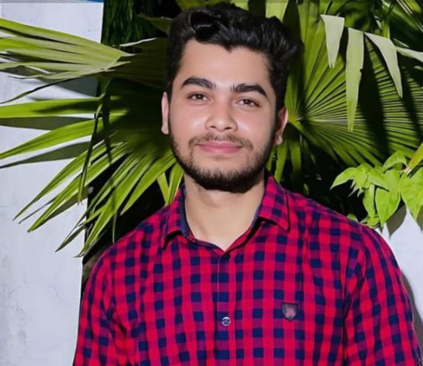
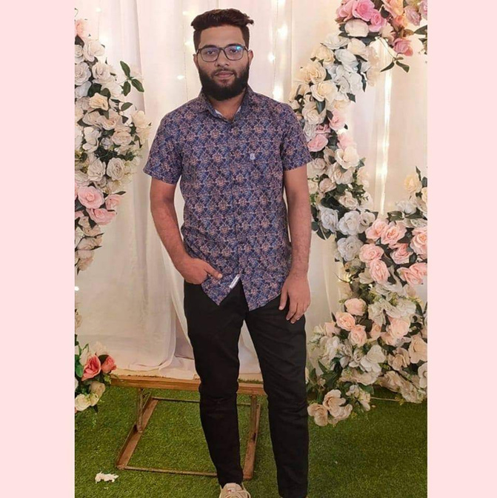
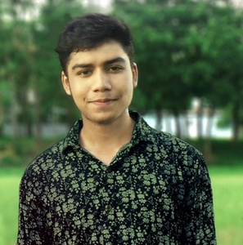
Let’s Meet Our Group!
Mamunul Kabir
Abdullah Akib
MD Shakib Hossain
MD Mishkatul Islam

Slide 3
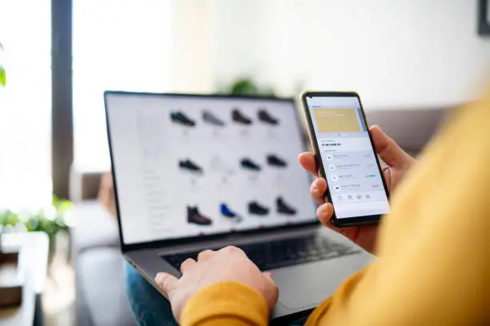
CONTENT
1. Introduction
2. Project Organization
3. Hardware and Software Requirements
4. System Architecture
5. Class Diagram of your System
6. Project Demonstration
7. Testing
8. Limitation

Slide 4


OVERVIEW
Shopping Zone Overview
Type: E-commerce Platform
Framework: Laravel
Description:
Shopping Zone is a user-friendly e-commerce site offering secure payments, product management, and order tracking.
Objectives:
Deliver a reliable and high-performance shopping experience.
Target Audience:
Consumers and small to medium-sized businesses.
Future Enhancements:
AI recommendations and loyalty programs.

Slide 5

Shopping Zone
PROJECT ORGANIZATION
PROJECT
MANAGER
DEVELOPMENT TEAM
Oversees project timelines, resource allocation, and team coordination.
Responsible for coding, testing, and implementing features using Laravel.
DESIGN
TEAM
QUALITY
ASSURANCE
Focuses on creating a user-friendly interface and responsive design.
Ensures functionality, performance, and security through thorough testing.

Slide 6
Shopping Zone
HARDWARE & SOFTWARE REQUIREMENTS
Hardware:
Server: 2+ CPU cores, 4+ GB RAM, SSD storage
Client: Any modern web browser
Software:
Server: Linux (Ubuntu/CentOS), Apache/Nginx, PHP 7.4+, MySQL/PostgreSQL
Development: Laravel, Composer, Git
Frontend: HTML5, CSS3, JavaScript (optional frameworks)
Security: SSL certificate, firewall, antivirus

Slide 7
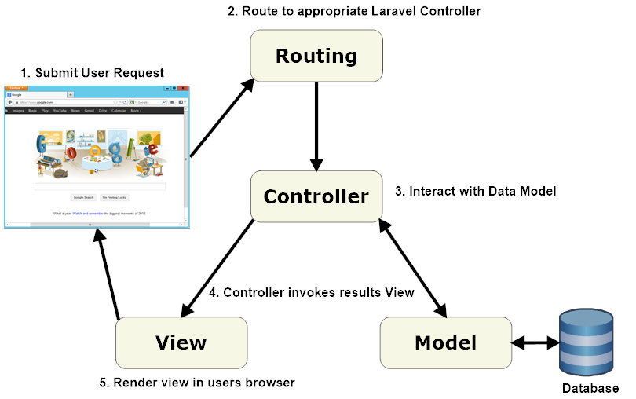
Shopping Zone
SYSTEM
ARCHITECHTURE

Slide 8
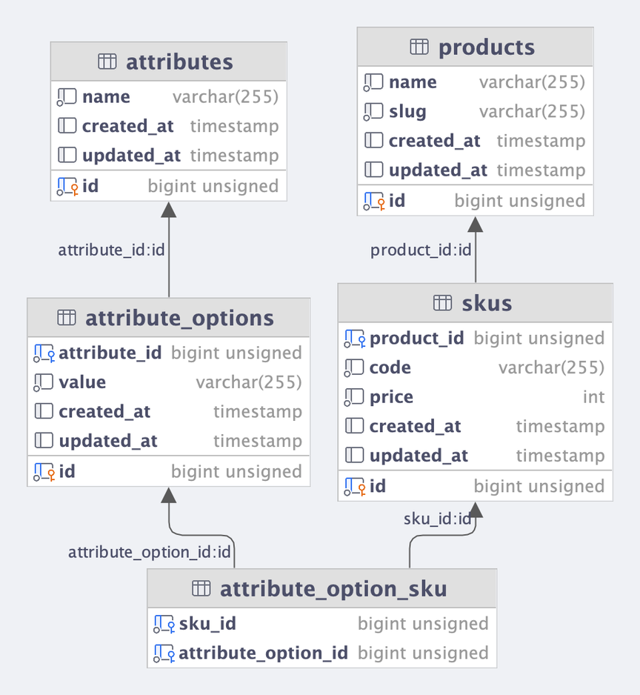
Shopping Zone
CLASS DIAGRAM

Slide 9
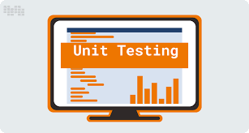
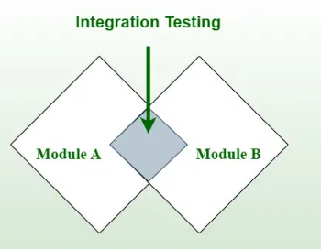
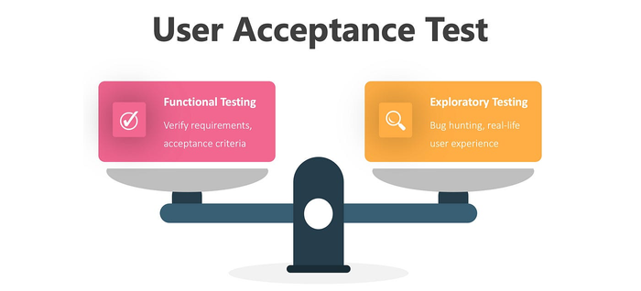
Consequences of Stress
Shopping Zone
TESTING
3 TESTING
Unit Testing: Testing individual components for functionality and reliability.
Integration Testing: Ensuring that different modules work together seamlessly.
User Acceptance Testing (UAT): Validating the system against user requirements and expectations.

Slide 10
Shopping Zone
CONTRIBUTIONS
Akib:
Set up Laravel project and configured environment.
Developed user authentication and multi-role access.
Implemented routing and middleware for secure access.
Managed database migrations and seeding.

Slide 11
Shopping Zone
CONTRIBUTIONS
Shakib:
Designed and optimized the database schema.
Created RESTful API endpoints for product management.
Integrated external APIs for product details.
Handled data validation and error handling in the backend.

Slide 12
Shopping Zone
CONTRIBUTIONS
Mamun:
Built responsive frontend using JavaScript and SCSS.
Designed user-friendly UI and ensured cross-browser support.
Implemented dynamic product pages and search functionality.
Optimized frontend performance and loading speed.

Slide 13
Shopping Zone
CONTRIBUTIONS
Mishkat:
Integrated payment gateway for checkout process.
Developed cart and order management system.
Implemented discount and coupon functionality.
Ensured secure handling of payment and user data.

Slide 14
Shopping Zone
LIMITATIONS
Security Concerns: Vulnerability to cyber-attacks, requiring robust data protection.
Technical Issues: Downtime, slow loading, or payment errors affecting user experience.
Lack of Personal Touch: No face-to-face interaction, reducing customer trust and loyalty.
Shipping Challenges: Delays, high costs, and logistics issues, especially for global shipping

Slide 15



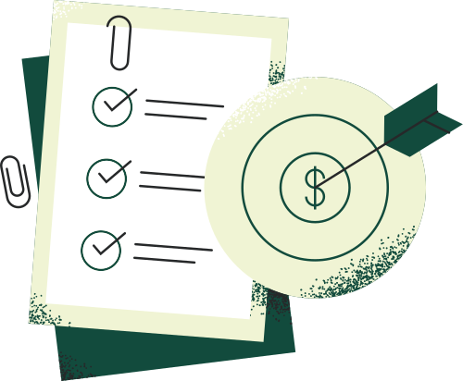


Any Query?
let us know...

Slide 16
Thank You

